Slide 1
SmartFall
Three AI models. One smart dashboard.
Stroke
Fall
Fall-risk prediction prototype · Presented by Pragati
Gait
Notes:
Hello everyone. SmartFall is my project that uses three separate AI models and brings their results together in one dashboard. I will explain each model in simple words, show how I built it in RapidMiner, and then show how I combined everything.

Slide 2
SmartFall asks three simple questions
1
2
3
Is this person at higher risk of stroke?
Did a fall just happen?
Is the way they walk changing over the days?
Model: Gradient Boosted Trees
Data: Kaggle stroke dataset
Model: Random Forest
Data: UniMiB SHAR sensor data
Model: LSTM neural network
Data: Synthetic daily gait data
Each model answers one question. Together, their answers go into one dashboard.
Notes:
Think of SmartFall as three helpers. One looks at stroke risk, one checks if a fall happened, one watches if the walking pattern is changing over many days. Each helper uses its own data and its own model.

Slide 3
Three datasets, three models, three outputs
DATA
MODEL
OUTPUT
Gradient Boosted Trees
Stroke risk score and risk band
1
Kaggle Stroke Prediction
5,110 people records
Random Forest
Fall or normal activity, with a probability
2
UniMiB SHAR
10,831 sensor windows
LSTM
Stable, gradual drift, sudden change or temporary change
3
Synthetic daily gait
24 people × 30 days
Last step: all three outputs are joined into one table and shown in a Mendix dashboard.
Notes:
Left to right: the data, the model I used on it, and what comes out. The three datasets are different and have no common person ID. That matters later when I combine them.

Slide 4
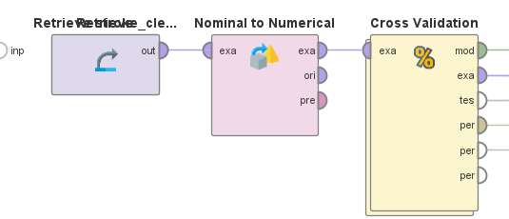
Model 1: Stroke risk from Kaggle data
5,110
249
people records
had a stroke (4.87%)
Where from: public Kaggle Stroke Prediction dataset.
What the model sees: age, BMI, glucose level, hypertension, heart disease, smoking status.
Cleaning: missing BMI values were filled with the average BMI.
The RapidMiner process, step by step
Retrieve data: load the cleaned stroke table.
Nominal to Numerical: turn text values (like “smokes”) into numbers.
Cross Validation: train and test the model several times on different parts of the data.
Notes:
The stroke data is a public Kaggle dataset with 5,110 records. Only 249 people had a stroke, about 4.9 percent, so the data is very imbalanced. In RapidMiner I loaded the data, converted text columns to numbers, and used Cross Validation so the model is tested fairly.

Slide 5
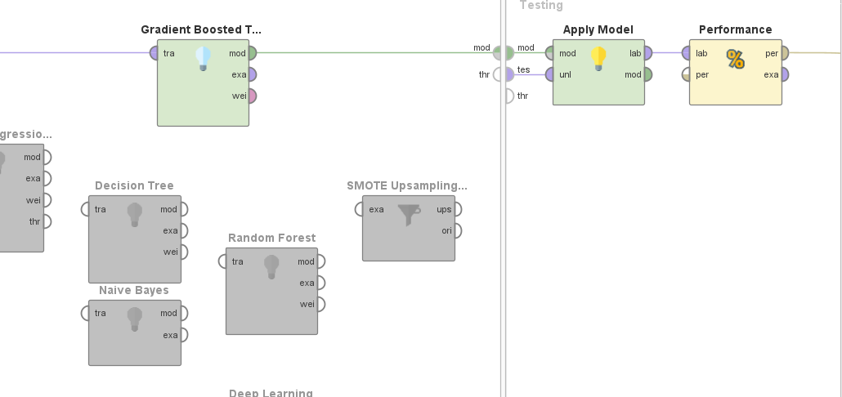
Stroke model: Gradient Boosted Trees
How GBT works
It builds many small decision trees, one after another. Each new tree learns from the mistakes of the trees before it. Together they give a stroke-risk score.
91.25%
0.833
Inside Cross Validation. Left side: the model is trained (Gradient Boosted Trees). Right side: Apply Model and Performance test it. The grey boxes are other options in the same process that were not used.
accuracy
ROC-AUC
Notes:
Inside Cross Validation the left side trains the model and the right side tests it. I used Gradient Boosted Trees. Result without SMOTE: 91.25 percent accuracy and ROC-AUC 0.833. ROC-AUC tells how well the model ranks risky people above safe people; 1.0 is perfect, 0.5 is guessing.

Slide 6
Why accuracy alone can fool you
95.13%
A lazy model that always says “no stroke” scores this, and finds zero strokes.
91.25%
Our model scores a bit lower, but it does find some real strokes.
20.0%
26.5%
22.8%
Precision
Recall
F1 score
Of people flagged, about 1 in 5 really had a stroke.
It found about 1 in 4 of the real stroke cases.
One number that balances precision and recall.
On the dashboard the stroke score becomes a band: top 5% = high, next 20% = moderate, the rest = low. It is a ranking for the prototype, not a medical diagnosis.
Notes:
Only 4.87 percent of people had a stroke. So a model that always says no stroke is right 95 percent of the time but useless. That is why I also report precision, recall and F1. My model finds about one in four strokes. It is a risk score for the prototype, not a diagnosis.

Slide 7
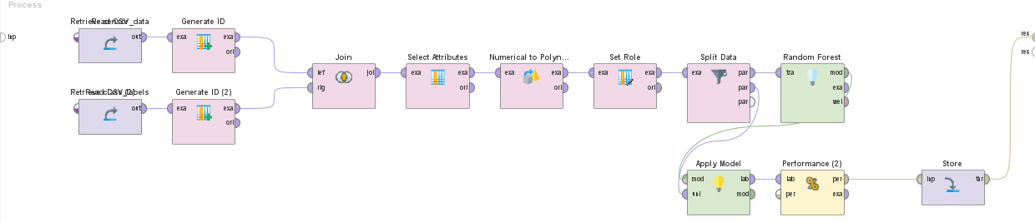
Model 2: Fall or normal activity?
RapidMiner process: read data + labels → join them → pick the label column → split into train/test → Random Forest → Apply Model → Performance → Store results.
What it does
97.9%
Be careful
Reads phone-sensor windows (10,831 left after removing 940 duplicates). Random Forest = many decision trees that vote: fall, or normal activity (ADL).
Likely too optimistic: sensor windows overlap and the test data is not split by person.
accuracy
Fall recall 95.8% · precision 97.1%
Notes:
This is the UniMiB SHAR fall dataset. The sensor data and the labels came in as two files, so I joined them using generated IDs, then trained a Random Forest. It reaches about 97.9 percent accuracy, but that is probably optimistic because the windows overlap and I did not split by person.

Slide 8
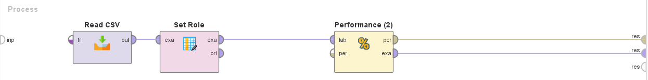
Model 3: Spotting gait change with LSTM
The data
Synthetic (simulated): 24 people × 30 days = 720 rows. Five daily numbers: gait speed, step-time variability, turn duration, sway, acceleration.
RapidMiner: Read CSV (LSTM predictions) → Set Role (mark the label) → Performance (accuracy).
The task
Look at each person’s 30 days in order and label the pattern: stable, gradual drift, sudden change or temporary change.
LSTM in plain words
How it was trained
A neural network with memory. It reads the 30 days in order and remembers the important earlier days. A normal model would look at each day alone.
Outside RapidMiner: Python with TensorFlow/Keras, run from the command line (CMD). RapidMiner only loads the predictions CSV and measures accuracy.
Notes:
The gait data is synthetic, I generated it, because I do not have real day-by-day gait recordings for the same people. The LSTM itself was trained outside RapidMiner, using Python and TensorFlow from the command line. I then brought the predictions CSV into RapidMiner to measure accuracy.

Slide 9

LSTM results: what the numbers really say
66.7%
First train/test split
RNN and LSTM tied. But the LSTM scored 100% on training and about 50% on validation, which means it memorised (overfitting).
RapidMiner Performance output: accuracy 0.689
45.8%
4-fold cross-validation
Mean accuracy for both models, split by person. This is the more careful number.
Say it plainly
This is an experiment on synthetic data. It shows the pipeline works. It does not show the model is ready for real patients.
68.9%
45-row prediction file
The check done in RapidMiner. A small pipeline test, not the same experiment.
Notes:
Three numbers, three different tests. The first split gave 66.7 percent but the model overfit. The careful cross-validation gives 45.8 percent. The 68.9 percent is from a small 45-row prediction file, which I use to prove the pipeline works. Please do not mix these numbers together.

Slide 10
Building the master table in RapidMiner
1
2
3
4
5
P1: Random Forest scores the fall windows. Saved as fall_scored.
P2: Gradient Boosted Trees gives stroke risk bands. 6 adults (50+) become person profiles.
P3: Start from the 45-row LSTM table. Add deviation and lag features.
No shared ID exists, so join stroke and fall results using person and row keys. Then add the alert level.
Clean in Turbo Prep, then export one CSV for Mendix.
Important: the link between datasets is simulated (is_simulated_link = true). It shows how the pipeline works. It does not mean the three models looked at the same real person.
Files joined: smartfall_lstm_v2_predictions.csv · gradientboostingfinal_withoutsmote.csv · smartfall_combined.csv
Notes:
I built the master table in RapidMiner with three processes. P1 runs the Random Forest on the fall windows and stores fall_scored. P2 runs Gradient Boosted Trees on the stroke data, creates risk bands, and picks 6 adults aged 50 or older as person profiles. P3 starts from the 45-row LSTM table, adds deviation and lag features, and joins the stroke profiles and fall windows using person and row keys, then adds the alert level. The three datasets share no real ID, so the link is simulated and marked that way. I then cleaned the table in Turbo Prep and exported one CSV for Mendix.

Slide 11
After the join: check for missing values
1
Expected gaps
2
Join gaps
3
Source gaps
Each person’s first day has no “yesterday”, so lag columns are empty (6 rows). This is normal, not an error.
A row found no match in another table. The key may be wrong, so fix the key before deleting anything.
The original data was blank, for example BMI in the stroke data. It was filled with the average.
Final checks before export
45 rows · persons P01, P02, P06, P09, P15, P17 · join did not multiply rows · CSV imports cleanly into Mendix
Notes:
After the join I opened the table in Turbo Prep and looked at the missing values. Not all missing values are the same. Some are expected, like the first day of each person. I check the reason before removing anything. Adjust this slide to say exactly what you did in Turbo Prep, for example if you removed rows with missing values.

Slide 12
How the final alert is decided
Check 1
FALL_ALERT
The fall model says “fall”.
Check 2
WARNING
The gait change keeps showing up day after day (persistent deviation).
Check 3
WATCH
The gait deviation score is 0.5 or higher.
Check 4
OK
None of the above.
The first check that is true wins. Stroke risk is shown next to the alert on the dashboard but never changes it.
Notes:
The alert follows a priority order. A detected fall is the top alert. Otherwise, a gait change that persists is a warning. Otherwise a high deviation score is a watch. Otherwise everything is OK. Stroke risk is displayed separately and does not change the alert.

Slide 13
All accuracies in one place
Stroke 91.25%
Data is very imbalanced. Recall is only 26.5%.
Fall 97.9%
Probably optimistic: overlapping windows.
LSTM 45.8% to 68.89%
Small synthetic data. An experiment.
Different data and different tests, so compare the bars with care.
Notes:
Here are all the accuracies together. Remember they come from different datasets and different tests, so do not read this as a ranking.

